Slide 1

The Biodiversity Crisis is at least
as important as the Climate crisis!
Katherine Richardson, Professor

Slide 2
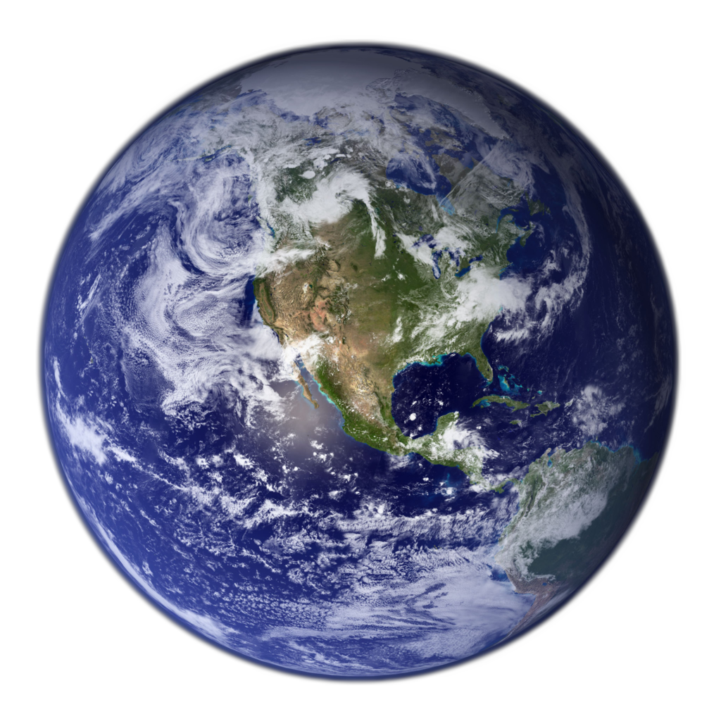
What makes this planet unique is life!
Notes:
”logik for dværghøns”?
MDG
Rio+20

Slide 3
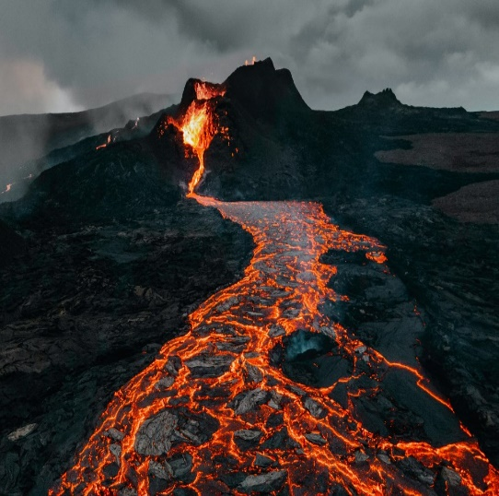
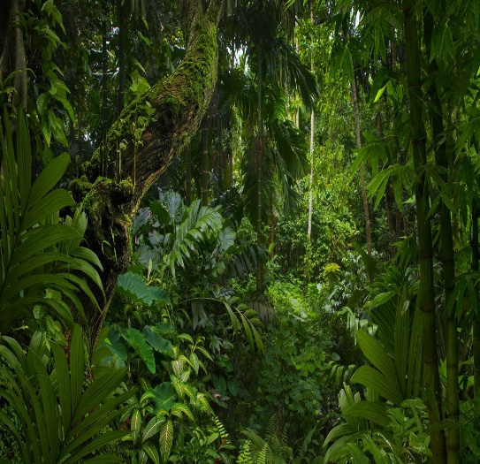
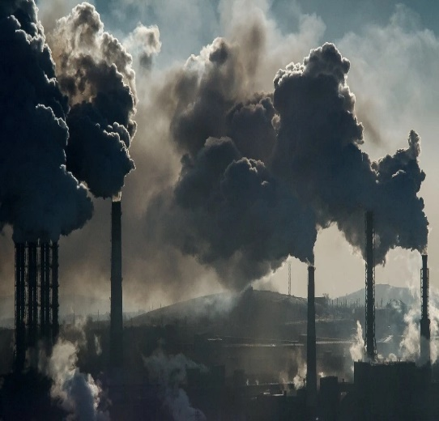
For billions of years, it was only the interactions between the “Geosphere” (energy and materials) and the “Biosphere” that determined conditions on Earth!
Biodiversity crisis is at least as important as the climate crisis!
Geosphere
Energy (climate)
Materials
Biosphere
All living organisms
People
“Anthroposphere”
“Anthropocene”
Notes:
”logik for dværghøns”?
MDG
Rio+20

Slide 4
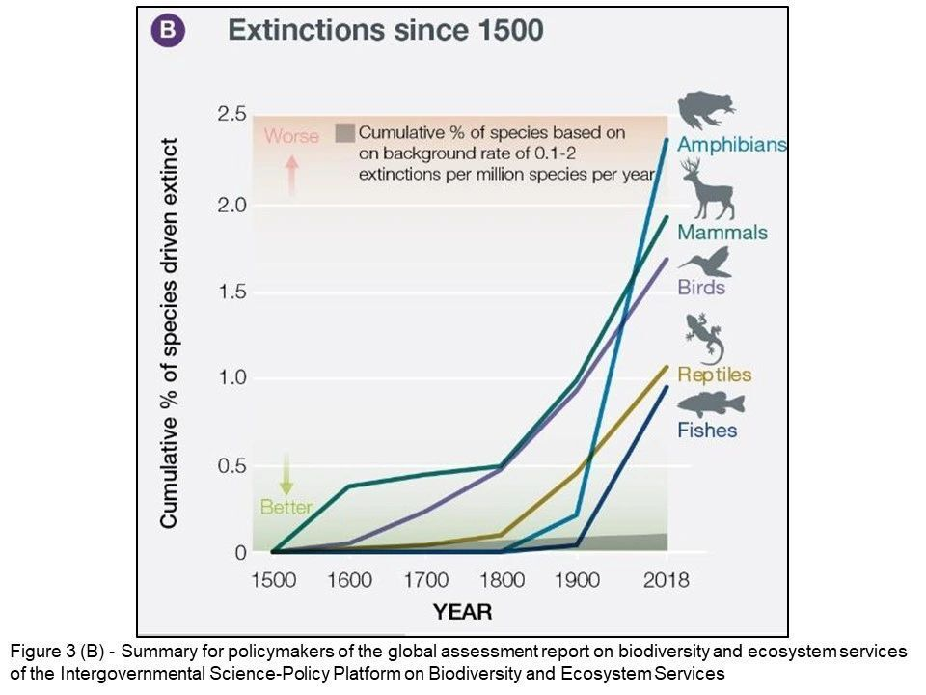
Alarming rate of species extinction!
Shocking changes in the composition of life!

Slide 5


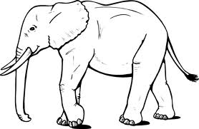
Terrestrial vertebrate biomass
Vertebrate
wildlife
< 3%
Humans
ca 32%
Domesticated animals
ca 65%
Smil 2002

Slide 6
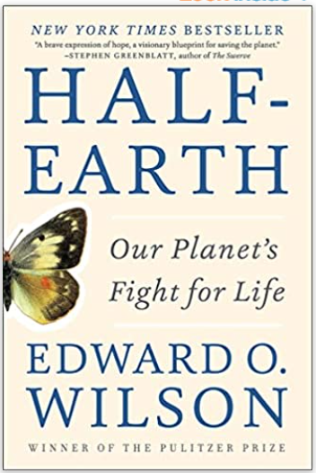
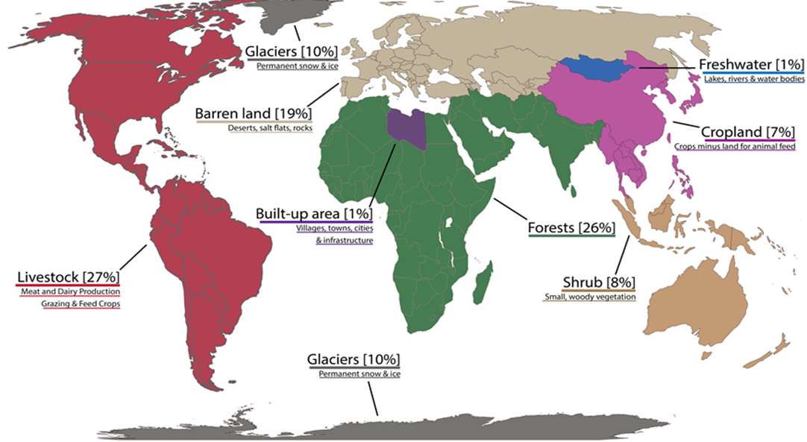
Greatest threat to biodiversity is lack of space!
How do we use the Earth’s area?

Slide 7
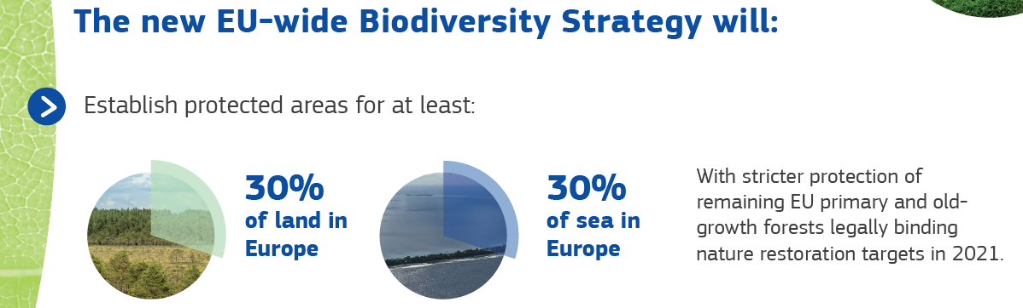
Increased efficiency in land use will “pay”! Demand for land use can be used as a metric for biodiversity impacts.

Slide 8
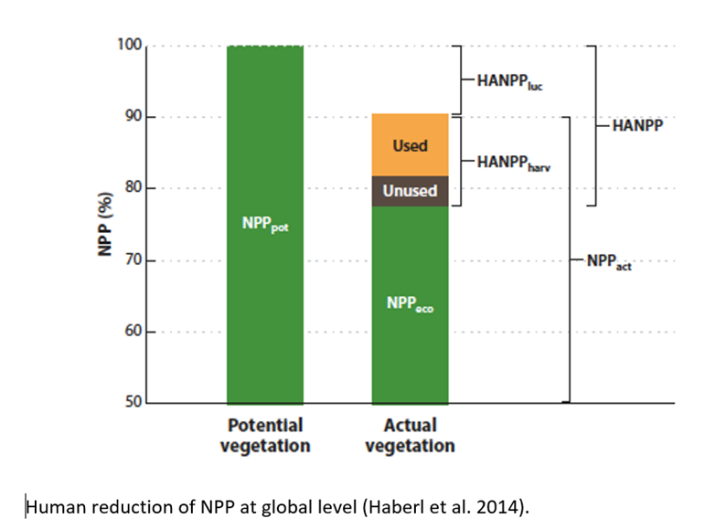
We are using 1/3 of the energy historically available to nature!
The Earth’s primary production is the energy source supporting biodiversity
The primary production (biomass) we use cannot be used by nature!
Beware of investments based on biomass!

Slide 9
Big data is increasing transparency with respect to biodiversity impacts of business!

Slide 10
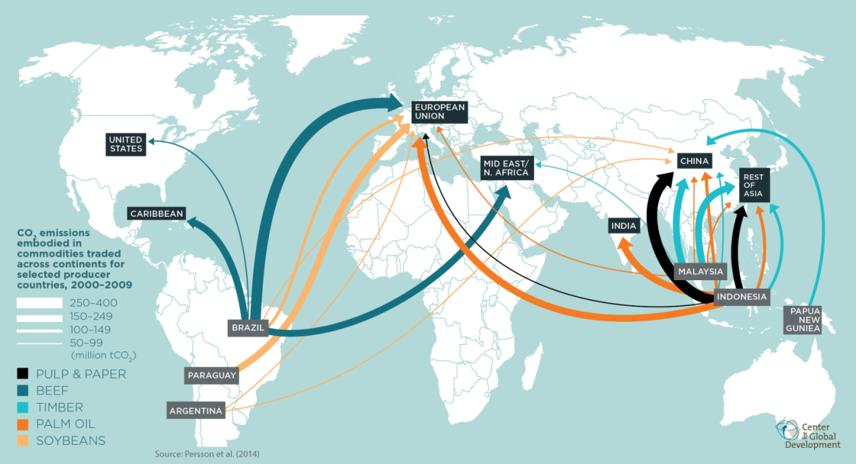
Major commodity trade routes
Notes:
Understanding agricultural commodity impacts
International supply chains are good tools to track drivers

Slide 11

Example: palm oil
Plantations
Smallholders
Mill
Storage, transport, shipping
Netto, Fakta, Irma, Rema 1000, Føtex…
Novozymes, Danisco, Palsgaard
Product
Manufacturers
Retailers
Refiners & Blenders
Ingredient Manufacturers
AAK, DLG, DLA Agro
Mendelez/Kraft
Toms

Slide 12
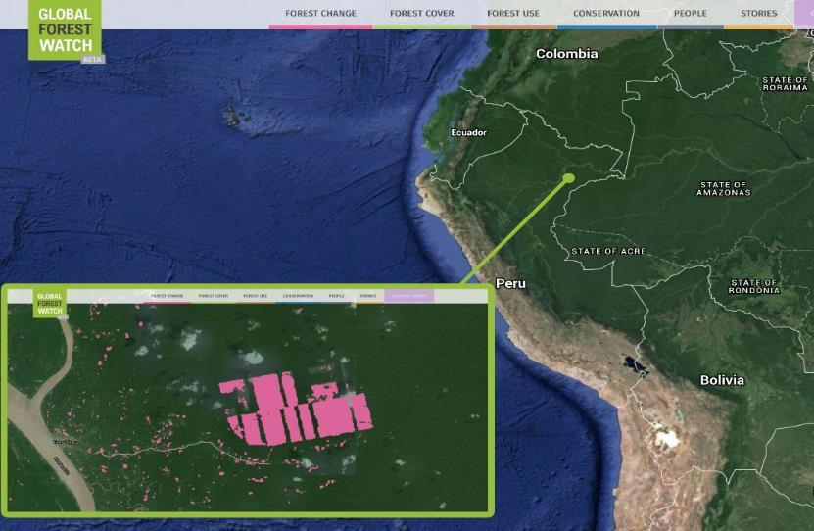
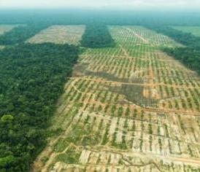
Measuring the impacts of a single threat on multiple species
www.globalforestwatch.org
Notes:
Finally, in Peru, a company claiming to produce sustainable cacao was caught red-handed converting over 2,000 hectares of primary rainforest into new plantations. GFW’s monitoring systems detected the deforestation, our local partner in Peru investigated the situation on the ground, and the story made international headlines. Over 60 organizations have petitioned the London Stock Exchange to remove united cacao from its listings. The government of peru has launched a criminal investigation, and in the meantime United Cacao and its subsidiaries have been trying to sell off their land.

Slide 13
Greenwashing
A product or service cannot – on its own – be “sustainable”!

Slide 14
Biodiversity: Investment and Business
Global:
Include biodiversity impacts in reporting (biomass or land-use)
Set goals!
Increase efficiency of land use (can include restoration or compensation)
Transparent supply chains
Local:
Visible local initiatives (insect hotel, grass -> mixed flower)
Employee activities

Slide 15
