Slide 1
Risk, Regulation, and Compliance (Part I)
Prof Tom Kirchmaier
Center for Corporate Governance, Copenhagen Business School
Centre for Economic Performance, London School of Economics
16 January 2020

Slide 2
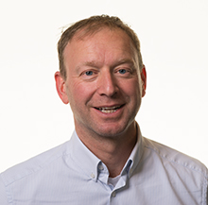
A word about myself
Professor for Risk, Regulation, and Compliance at Copenhagen Business School (CCG)
Member of the Centre for Economic Performance, London School of Economics (Crime Lab)
Previously: Financial Markets Group, London School of Economics
Interested in Boards, Banks, and Gender
PhD: London School of Economics on the Economics of the Firm
Empirical Economist (loves data)
German by birth, European by heart
Notes:
Interested in when where and why public is endangered
Fits the interests of both police forces and HMIC
GMP’s purpose “Protect society and help to keep people safe”
HMIC’s purpose “Promote improvements in policing and make everyone safer”

Slide 3
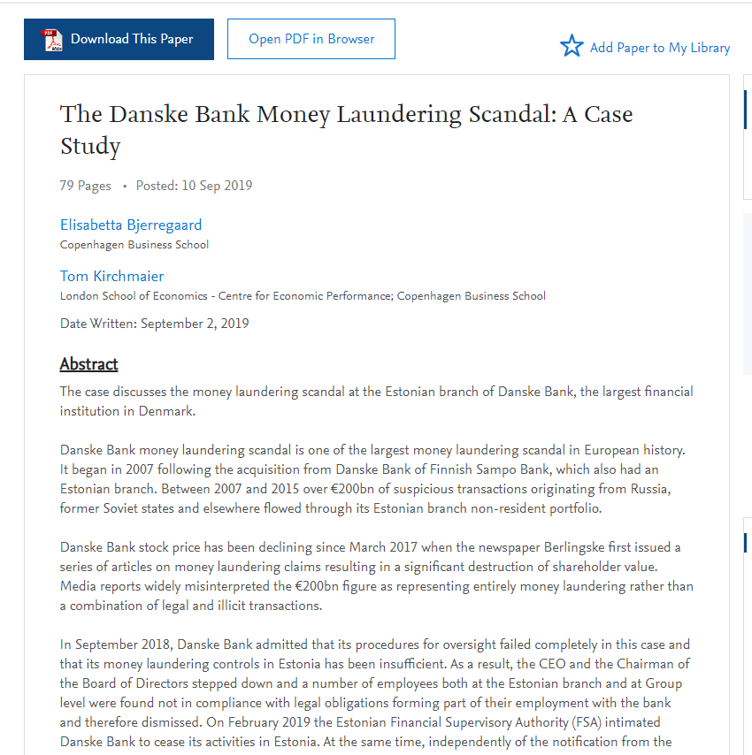
Disclosure
Link
Notes:
Interested in when where and why public is endangered
Fits the interests of both police forces and HMIC
GMP’s purpose “Protect society and help to keep people safe”
HMIC’s purpose “Promote improvements in policing and make everyone safer”

Slide 4
House Rule
Chicago Style: Ask whatever, whenever
(Let’s have a nice debate)
Notes:
Interested in when where and why public is endangered
Fits the interests of both police forces and HMIC
GMP’s purpose “Protect society and help to keep people safe”
HMIC’s purpose “Promote improvements in policing and make everyone safer”

Slide 5
Aim for Today
To debate concepts on GRC & AML
So you can ask the right questions
I will not focus on individual regulation
Notes:
Interested in when where and why public is endangered
Fits the interests of both police forces and HMIC
GMP’s purpose “Protect society and help to keep people safe”
HMIC’s purpose “Promote improvements in policing and make everyone safer”

Slide 6
Risk ‘Waterfall’
Risk
Regulation
Compliance often seen as a necessary evil, and one that does not add value
Key in helping to reduce risk in complex systems
Effective, and underappreciated, way of creating value in organisations
Often the only way to be able to run complex operations
Compliance
Notes:
Interested in when where and why public is endangered
Fits the interests of both police forces and HMIC
GMP’s purpose “Protect society and help to keep people safe”
HMIC’s purpose “Promote improvements in policing and make everyone safer”

Slide 7
Back to Basics
Possibly obvious, but still important

Slide 8
Definitions
Risk – the quantitative assessment of (1) likelihood of unfavourable events occurring, and (2) likely loss resulting from it.
Uncertainty – the unquantifiable portion
Compliance – enforcement
Governance – making a strategic decision on how much risk a firm should take on (the boards role)
Notes:
Interested in when where and why public is endangered
Fits the interests of both police forces and HMIC
GMP’s purpose “Protect society and help to keep people safe”
HMIC’s purpose “Promote improvements in policing and make everyone safer”

Slide 9
The Sources of Rent How do firms/banks make profits?
Firms make calculated decisions on risk.
Theoretically, in competitive markets with equal inputs and regulation, risk management is the key differentiator
(outperforming the risk-reward relationship).
Notes:
Interested in when where and why public is endangered
Fits the interests of both police forces and HMIC
GMP’s purpose “Protect society and help to keep people safe”
HMIC’s purpose “Promote improvements in policing and make everyone safer”

Slide 10
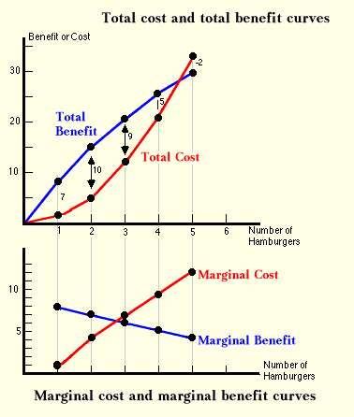
A Word on People Training Matters
Economists trained to think in marginal benefits and costs/risks
Lawyers trained to aim for zero risk / certainty
Notes:
Interested in when where and why public is endangered
Fits the interests of both police forces and HMIC
GMP’s purpose “Protect society and help to keep people safe”
HMIC’s purpose “Promote improvements in policing and make everyone safer”

Slide 11
A Word on Risk Data Matters
Financial organisations / banks find it terribly difficult to aggregate risk up in a meaningful way.
The non-quantification of risk means overreporting to board (together with the general risk-aversion).
Data and clear processes can help to manage financial and non-financial risk.
Notes:
Interested in when where and why public is endangered
Fits the interests of both police forces and HMIC
GMP’s purpose “Protect society and help to keep people safe”
HMIC’s purpose “Promote improvements in policing and make everyone safer”

Slide 12
A Word on Boards The Role of Boards
Boards set the strategic direction
Boards set the risk appetite
Boards set the principles
Boards set the tone
Boards don’t manage
Notes:
Interested in when where and why public is endangered
Fits the interests of both police forces and HMIC
GMP’s purpose “Protect society and help to keep people safe”
HMIC’s purpose “Promote improvements in policing and make everyone safer”

Slide 13
On Risk

Slide 14
Compliance is the Mirror of Risk A call to conceptually integrate thinking and process
Understanding risk is a competitive advantage, if it is carried through by the organisation (compliance)
Risks
Problems / Issues
Risks are potential future problems
A risk should answer these 3 questions:
What can/will go wrong?
Why will it happen?
Why is this risk a problem?
Establish probability of occurrence and likely loss
Identify mitigating actions
Enables mandatory reporting and follow-up on correct level
Enables integrated reporting with risk appetite and limits
Problems/issues are “hick ups” in the daily operations and systems
Problems/issues have occurred and need to be resolved
Mitigation actions need to be identified and implemented
Problems/issues should be analysed and used for input when identifying new potential risks
Vs.
Notes:
Interested in when where and why public is endangered
Fits the interests of both police forces and HMIC
GMP’s purpose “Protect society and help to keep people safe”
HMIC’s purpose “Promote improvements in policing and make everyone safer”

Slide 15
Risk Strategies How to deal with it
ACCEPT
MITIGATE
AVOID
Notes:
Interested in when where and why public is endangered
Fits the interests of both police forces and HMIC
GMP’s purpose “Protect society and help to keep people safe”
HMIC’s purpose “Promote improvements in policing and make everyone safer”

Slide 16
Risk Identification Data Matters
Understanding where and how risks emerge in the business is key
But how?
Emerging risks are hard to spot, as one doesn’t know where to look in a universe of possibilities
‘Known and unknown unknowns’
Far too much data, and not enough information
Expert judgment helpful but not unbiased, nor complete
Good empirical work (Econometrics / ML) can help to identify patterns, early indicators, and to quantify a distribution of the risk
We can analyse both financial and non-financial risk
It requires a stringent collection and use of data throughout the organisation (bottom-up)
Notes:
Interested in when where and why public is endangered
Fits the interests of both police forces and HMIC
GMP’s purpose “Protect society and help to keep people safe”
HMIC’s purpose “Promote improvements in policing and make everyone safer”

Slide 17
Level 1 Risks
Credit Risk
Market risk
Liquidity Risk
Operational Risk
Model Risk
Insurance Risk
ESG Risk
Business Model Risk
Compliance Risk
Level 2 Risks
Counterparty Risk
Default Risk
Recovery Risk
Concentration Risk
Specialised Lending Portfolio Risk
Securitisation Risk
Shadow Banking Risk
FX Risk
Interest Rate Risk
Credit Spread Risk
Equity Risk
Inflation Risk
Commodity Risk
Market Liquidity Risk
Wholesale Funding Risk
Deposit Risk
Funding Mismatch Risk
Intraday Risk
Off-Balance Sheet Risk
Marketable Asset Risk
Non-Marketable Asset Risk
Process Risk
IT Risk
Reputational Risk
Conduct Risk
Products and services
Governance and internal processes
Financial Crime
Market Abuse
Prudential Reporting
Security
Data
Poor quant. models
Unexpected risk to due changes in assumption:
Longevity
Volatility
Climate
Changes in Consumer Expectations
Climate Change
Key Partner Risk
Key Activity Risk
Key Resources Risk
Fintech
(Regtech)
Adapted from CBS / Nordea / Plesner Course on Risk Management and Compliance

Slide 18
On Compliance
…

Slide 19
Compliance is a Function of Risk
(and risk is multi-dimensional)

Slide 20
Compliance efforts need to be proportional to risk
Regulator is interested in process, not ‘box-ticking’

Slide 21
Compliance Function Purpose
Monitor and assess effectiveness of methods and procedures to identify and mitigate risks
Report the findings to the Executive, and the Board of Directors
Requirements for compliance function:
is independent
no conflicts of interest
appoints staff responsible for compliance
bank allocates sufficient resources
staff has necessary competencies and knowledge to perform duties
staff has access to all relevant information

Slide 22
Compliance
Compliance tied to Banking License, for others relatively new (MIFID I, 2007).
Compliance costly
Compliance function can get very big, with little direct value added
Whistleblowing
Non-compliance also costly
Fines
Reputational damage (naming and shaming)
Trade-off between cost and benefits
Interesting cases
B737 Max
BP (Deepwater Horizon)

Slide 23
Three Lines of Defence
1st Line of Defence
2nd Line of Defence
3rd Line of Defence
Business
Group Risk & Compliance
Group Internal Audit
It is accountable for identifying, mitigating and reporting the risk status
Promotes the right risk culture
Operates within the agreed risk appetite
Works with the risk owners to ensure risks are identified, assessed, mitigated, monitored and reporting according to the agreed frameworks
Designs the risk management frameworks
Understands the regulatory environment and implication
Provides Policies & Guidelines
Ensures risk management oversight by independent monitoring and controlling of the 1st LoD
Internal audit is an independent and objective assurance activity designed to add value and improve the operations
Focuses on operational auditing of the internal control system
Execution
Monitoring & Control
Assurance
Adapted from CBS / Nordea / Plesner Course on Risk Management and Compliance.

Slide 24
Reporting Pyramid
Illustration of the Governance Hierarchy
High-level description
1
Final ratification of all material risk management decisions
Approval of Group risk appetite
Oversight of highest risk issues (e.g. regulatory issues)
1
Board
2
Approval of all material decisions regarding the management of non-financial risks
Oversight of key group metrics and high risk issues, including review of plans to close
2
Executive
3
Discussion of non-financial risk strategy and execution in the context of overall risk strategy
Advisory role to CEO and Group Board
Integrated Risk Reporting
3
Group Risk Committee
4
Ensures effective and consistent execution of non-financial risk activities across the 1 LoD through:
Oversight of 1 LoD non-financial risk metrics and high risk issues and risk appetite consumption
Decision-making power on significant 1 LoD non-financial risk issues
Sets mandates for Cross BA Sub- & Operational Forums
4
Operational Risk Committees
5
5
Determines common strategy for non-financial risk management across the Business Area / Country / topic
Oversight of the execution of BA non-financial risk strategy, decisions and review of key BA risk metrics
Set mandates for Business Units Sub-forums
1st Line of Defence Forums
2nd Line of Defence Forums
Adapted from CBS / Nordea / Plesner Course on Risk Management and Compliance.

Slide 25
Digitalization and Workflow
Humans are good making judgements, machines in performing routine tasks.
But we waste humans on routine tasks in compliance.
Rethink processes and workflows, optimise them, and then digitalise them.

Slide 26
Revisiting AML / CTF (Part II)
Prof Tom Kirchmaier
Center for Corporate Governance, Copenhagen Business School
Centre for Economic Performance, London School of Economics

Slide 27
Aim for Today
Understand causes of the AML system malfunctioning
Discuss & develop concrete steps on how to improve it
Notes:
Interested in when where and why public is endangered
Fits the interests of both police forces and HMIC
GMP’s purpose “Protect society and help to keep people safe”
HMIC’s purpose “Promote improvements in policing and make everyone safer”

Slide 28
Issues with AML Initiatives
Large issue, as 1-2% of GDP might be illegal economic activities (Globally ≈ USD 1 trillion (of 80)). ML issue might be larger.
Incredibly expensive for society
Cumbersome for banks, their staff, customers, and intermediaries
Very ineffectual
We might just find 1% of ML payments, if at all
Strong bias to detect the small, and unsophisticated ‘criminals’
Very profitable for consultants, TR(Refinitiv), etc.
Inefficient steady state?
Notes:
Interested in when where and why public is endangered
Fits the interests of both police forces and HMIC
GMP’s purpose “Protect society and help to keep people safe”
HMIC’s purpose “Promote improvements in policing and make everyone safer”

Slide 29
An Example From Europol
A payment processor for drug payments
Collects cash from street dealers throughout Europe; around €1bn annually
Counts it, launders it through European banking sector, and sends it back to the Americas as ‘clean’
Fee: About 6-7%. Expected detection likelihood: ≈0%
Origin: Lebanon, with possible links to Hezbollah
Notes:
Interested in when where and why public is endangered
Fits the interests of both police forces and HMIC
GMP’s purpose “Protect society and help to keep people safe”
HMIC’s purpose “Promote improvements in policing and make everyone safer”

Slide 30
A Reminder Sources of funds, classified as ML
Proceeds of (Serious) Criminal Activity
Drugs. Human Slavery. Child Sexual Exploitation. Racketeering. Fraud. Cyber & Organised Crime
Real impact on society, and asset prices (property & businesses)
Organised crime and jihadi groups increasingly intertwined (examples from Sweden and Denmark)
Embezzlement of State Funds, Tax Evasion, and Serious Corruption
Avoidance of Currency Controls (China)
[Terror Finance]

Slide 31
The Legal & Institutional Framework In need of restructuring
FATF (Born out of G7 in 1989): 40 rules
Rules written by lawyers for lawyers; very difficult to operationalise
Unclear how effective. In urgent need of a ‘complement’
Financial Investigation Units (FIUs)
Very under-resourced, as political priorities are with ‘classical policing’
High staff turnover, as Banks poach aggressively
Staffed by police men / women, with good investigative skills
Very short time window for investigation / decision on STRs
Banking Regulators
Historically limited use of powers and resources (see EBA, and others)
Branches vs Subsidiaries (remember AIG Banque – USD 180 billion bailout)

Slide 32
The Legal & Institutional Framework In need of restructuring
The Executive
Knee-jerk reactions: e.g. Prison sentences for Board Members
A global problem in search of a national ‘solution’. Delegate up to EU level?
No holistic approach to the issue at hand
FinTech
The ‘forgotten’ bad boy in the room?

Slide 33
On Data
The application to AML

Slide 34
Data Infrastructure The Current Issues
The data revolution has not yet arrived in the AML world
Far too much work is done manually, which is expensive and cumbersome, and leads to inconsistent outcomes
Detection algorithms focus on within account consistency, not across (very easy to circumvent)
Algorithms lack an outcome variable (prosecution/conviction), and hence are trained to detect a small number of known cases -> key role for universities
Substantial body of literature on SOC, but typically ethnographic, documentary, or biographic in nature, often picked up by the Media, and Hollywood.
This leads to a popular conception that is based on anecdotes rather than empirical work (which might feed back to policy making)

Slide 35
Data Infrastructure The Current Issues II
SARs / STRs
Banks overreport, while possibly protecting their best clients
Almost all SARs are not followed-up
Decision time an issue
The SARs data infrastructure is in urgent need of an overhaul - globally
KYCs central to the functioning of banks (counterparty risk)
Understand your customer. Important for AML, but even more so for the running of the bank
Standard Chartered – Dubai
No standardised data interchange across borders, institutions, and banks

Slide 36
In Summary
We fail in our objective
Our institutional structure is not delivering
Data and processes are inadequate on bank/fintech and supervisory level

Slide 37
What Next?

Slide 38
General Issue I In need of public debate
AML will never be risk-free!
(As is any business. Lawyers vs. Economists)
We need to define - in a political process - the accepted level of risk society is prepared to take?

Slide 39
General Issue II ‘The Nordics’
The Nordics have a beautiful culture of trust (to be protected)!
The Nordics are unprepared to deal with aspects of globalisation
The Nordics are very small – population wise
The Nordics are facing a big threat (jihadi)

Slide 40
Way Forward
Work together,
pool resources, and data!
*across banks
*across countries
*across institutions¹
¹ (FIU, Supervisor, Police, Intelligence services, …)

Slide 41
Way Forward
Standardise, Integrate, Automate

Slide 42
Way Forward
Standardise, Integrate, Automate
A Digitalisation Story, which will need to start with Processes, not Products

Slide 43
On Institutions
Selected Reform Proposals

Slide 44
On Institutions The General
We will need to rethink our decentralisation paradigm

Slide 45
On Institutions Proposal I
Combine FIUs and supervisory bodies, here the Danish FSA, under ‘one roof’
The FSA pays for all activities, including the FIU investigators who will work alongside and in close collaboration with the FSA staff
The financial supervisor understands banks much better than a FIU ever can, has access to their data, should have the empirical skills, and is much better resourced than the Police Service
Sovereign functions still with Police/FIU, but located within the supervisor’s organisation
Centralise on EU level into a new Supra-national body (French-Dutch Proposal)

Slide 46
On Institutions Proposal II: Standardise, Integrate, Automate across Nordics
Standardise
STR/SARs data collection across Nordics / Europe
Integrate
SARs data across Nordics / Europe (as part of the normal police information exchange)
Organised Crime Group data across Nordics (if not yet done), and integrate with FIU system/data
Current integration level of Intelligence data?
Share (SARs) data for research purposes
Sanctions list
Automate
Better algorithms, in part by:
Counterparty check with OCGM (ideally offer as an API service to Banks [+/-]).
Plausibility check via OpenCorporates / Experian / …
Pattern detection across countries, banks, etc.
Empirical knowledge is in universities

Slide 47
On Institutions Proposal III
Reorganised FSAs along clear lines of responsibilities, and without conflict of interest
Regulatory, Policy, and Algorithms (pre-legislative work)
Inspection (inspections into bank’s compliance with regulation)
Investigations (investigations under strengthened legal guarantees and legal controls, handed over from the Inspections Unit)
Enforcement

Slide 48
On Data
The application to AML

Slide 49
On Data The General
Society will win the AML race on its ability to:
collate, and analyse data very fast and cheap
execute resulting actions fast and cheap
(but here we will need a human at the end of process)
=> Standardise, Integrate, Automate

Slide 50
On Banks Proposal II: Standardise, Integrate, Automate across Nordics
Standardise
KYC data requirements (ideally just do it once)
Transaction data (Value in that data, but London data pool not successful)
Geographic information on the same level as open data (very promising!)
Integrate
KYC initiative for Nordics (currently only for commercial clients)
Transaction data pool, and networks (there is value in it, if done well)
Counter party information (with common rule book across Nordics)
Organised Crime Group data across Nordics (if not yet done), and integrate with FIU system/data
Pooling of SARs, and Geographic SARs information
Counterparty check with OCGM (ideally offer as an API service to Banks [1/0]).
Plausibility check via OpenCorporates / Experian / …
Sanctions list
Automate
Better algorithms, in part by tailoring algorithms to use cases (1-4)
Allowing universities to contribute, and give access to outcome variables
See above counter-party info requirements

Slide 51
On Detection An Example
We devised a new, devilishly simple, and effective way of
detecting ‘problematic’ accounts.

Slide 52
https://point.exposed

Slide 53
Nordic Finance and the Good Society
CCG Research Programme

Slide 54
Nordic Finance and the Good Society – Part II
“Finance is not merely about making money. It's about achieving our deep goals and protecting the fruits of our labour. It's about stewardship and, therefore, about achieving the good society”
― Robert J. Shiller
Based on the first part of the research project, new relevant research areas have been identified.
The complexity at the macro and micro level is further increased in the financial sector.
More focus on the Nordic countries and the larger EU with Part II.

Slide 55
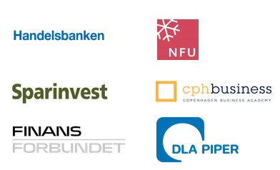
NFGS part II
Sponsors
Partners

Slide 56
Research team (in progress)
Researcher | University | Research area
ALEXANDRA ANDOV | KU | Compliance & Regulation
ANNA LINDA MUSACCHIO ADORISIO | CBS | Sustainable Finance
ARTURO BRIS | IMD | Competitiveness and Business Models
BARBARA SEITZ | CBS
BERSANT HOBDARI | CBS
BJØRN PREUSS | CBS
CAREN YINXIA NIELSEN | CBS | Long-Term Ownership in the Financial Sector and the Nordic Model
GEORG RINGE | Hamburg | Compliance & Regulation
HANNE BIRKMOSE | AU | The Value of Financial Advice - Compliance & Regulation
JAN DAMSGAARD | CBS | Technology, Crypto-currencies and Blockchain
JESPER LAU HANSEN | KU
JONAS HEDMAN | CBS | Technology, Crypto-currencies and Blockchain
KAI HOCKERTS | CBS | Sustainable Finance
Researcher | University | Research area
LARS CHRISTENSEN | The Market Monetarist | Low inflation and monetary policies
LARS OHNEMUS | CBS | Competitiveness and Business Models
MARC STEFFEN RAPP | Marburg | The Value of Financial Advice
MARINA BITSCH MADSEN | AU | Equal Access to Financing - A local perspective on finance, employment and sustainability
NIELS WESTERGÅRD-NIELSEN | CBS | Equal Access to Financing - A local perspective on finance, employment and sustainability
OSCAR STOLPER | Marburg | The Value of Financial Advice
PETER BOGETOFT | CBS | Competitiveness and Business Models
PHILIPP KRÜGER | GSEM | Sustainable Finance
TANJA JØRGENSEN | AU / On leave until aug. 2020 | Compliance & Regulation
THERESE STRAND | CBS | Long-Term Ownership in the Financial Sector and the Nordic Model
THOMAS POULSEN | CBS | Equal Access to Financing - A local perspective on finance, employment and sustainability
TOM KIRCHMAIER | CBS | Risk & Anti-Money Laundering

Slide 57
Contact
Prof Tom Kirchmaier
E: tk.ccg@cbs.dk
T: +45 3815 2650

