Slide 1
The 2021 PRI Reporting Cycle: Overview and Key Changes
For IcelandSIF members
2 March 2021 | 9.00am (GMT)
Yulia Sofronova, Co-Head of Nordics, Head of CEE & CIS, PRI​

Slide 2
AGENDA
Investor reporting framework overview: snapshot and timelines
Key changes to 2021 investor reporting framework and modules overview
Assessment methodology
Navigating the new reporting platform
Resources
Q&A session

Slide 3
Overview of Investor Reporting Framework

Slide 4
2021 Reporting timeline
Reporting is mandatory for all signatories to maintain their signatory status
August
Reporting outputs released
July – November
November
Feb – April
May - July
Module development and changes to the framework
Release of next year’s reporting framework
PRI signatories report on RI activities
Data analysis and creation of reporting outputs
Live reporting period
Online Tool Closed
Investor reporting cycle deadline: 29 April 2021

Slide 5
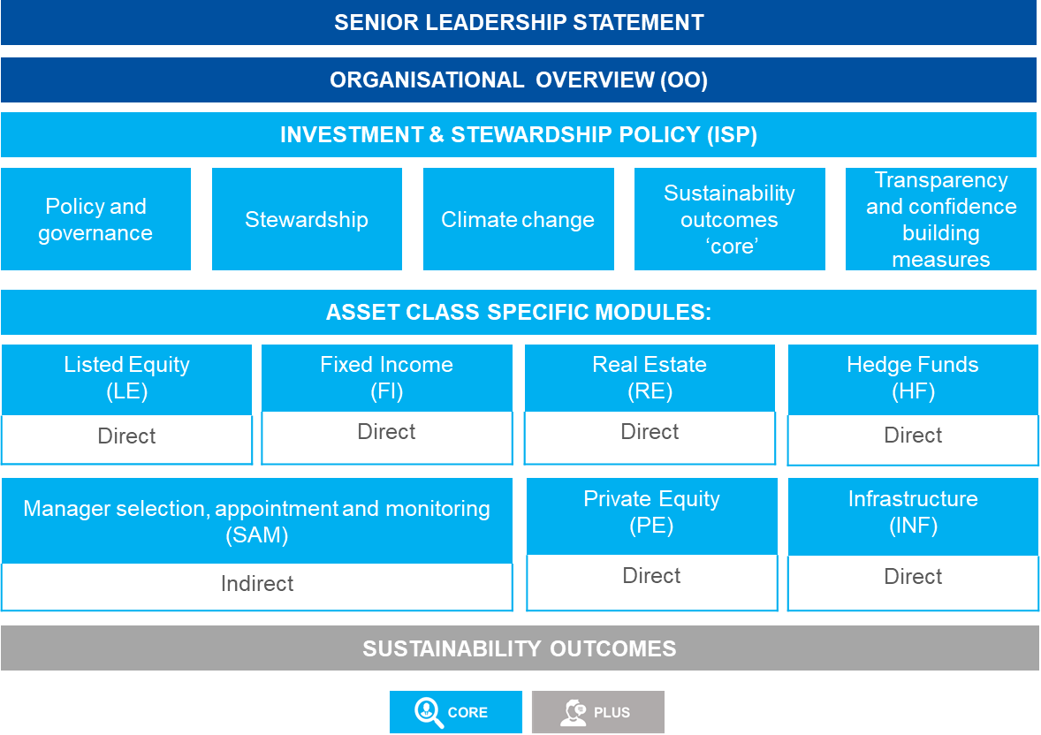
Investor Reporting Framework
Modules and short guides are downloadable at Investor reporting guidance

Slide 6
Key changes to the 2021 Investor Reporting Framework

Slide 7
Simpler, shorter and more consistent
Introduction of ‘Core’ and ‘Plus’ model to simplify the reporting process
Decrease in number of indicators compared to 2020
~50%
CORE
PLUS
Mandatory
Public
Assessed
Relatively stable
Process-focussed
Closed-ended questions
Voluntary
Public or private (signatories’ choice)
Not assessed
Evolving
Process- and outcomes focussed
Mostly open-ended questions

Slide 8
Evolved and more challenging
The modules are more challenging because they focus on the robustness and depth of signatories’ ESG processes
Process oriented
Capturing robust ESG incorporation
Depth
Understanding the depth of ESG activities
How ESG factors are incorporated
Evolved
Aligned with existing PRI work
AUM coverage for a practice

Slide 9
Senior leadership statement
To raise awareness and accountability of PRI reporting
Overview of signatory’s approach and achievements on RI
Introduces reporting outputs
Signed by senior leadership (CEO, CIO or similar)
Mandatory for all signatories
Not assessed

Slide 10
Structure of the statement
Four Sections
1. Our commitment
2. Annual overview
3. Next steps
Why we engage in RI
Overall approach to RI
How RI adds value to our activities
This year's progress on RI, achievements, etc.
Plans for next 2 years
4. Endorsement
signed by senior leadership
Providing their name and position
Endorsement limited to the SLS, not to all the information reported in the RF

Slide 11
Organisational Overview
Mandatory for all signatories to report on i.e. all ‘Core’ indicators
Assets under management [OO 4] – signatories to complete by 31 March
Assets class breakdown and sub-strategies [OO 5]
ESG incorporation [OO 10, 11, 12, 13] – affects assessment
Reporting on voluntary modules [OO 14]
Acts as a gateway to the rest of the Reporting Framework

Slide 12
Investment & Stewardship Policy (ISP)
Covers firm-wide RI themes that are applicable across all assets and is mandatory for all signatories to report on
Module sections
POLICY & GOVERNANCE
STEWARDSHIP
-21%
CLIMATE CHANGE
SUSTAINABILITY OUTCOMES
TRANSPARENCY & CONFIDENCE-BUILDING MEASURES

Slide 13
Investment & Stewardship Policy (ISP): minimum requirements
The minimum requirements are clearly highlighted in orange and captured in the policy and governance section of ISP. See minimum requirements for investor membership for more information.
How the minimum requirements indicators map from old SG module to new ISP:
Example of the minimum requirements indicator in ISP:

Slide 14
Investment & Stewardship Policy (ISP): stewardship
Stewardship not assessed in separate module – included in module scores
?
Stewardship not assessed in separate module – included in module scores
Extensively covered in the ‘ISP’ module to avoid repetition – aligned with STW 2.0 paper
Extensively covered in the ‘ISP’ module to avoid repetition – aligned with STW 2.0 paper
Stewardship incorporated throughout the framework
In relevant asset class modules for asset-specific stewardship practices
In relevant asset class modules for asset-specific stewardship practices
More space to report on (proxy) voting, shareholder resolutions and engagement with policy-makers
More space to report on (proxy) voting, shareholder resolutions and engagement with policy-makers
The indicators are aligned with the PRI’s paper Active Ownership 2.0
Notes:
.

Slide 15
Investment & Stewardship Policy (ISP): climate change
Climate change-related indicators mandatory in 2020 will now be in ‘core’ section
Climate change-related reporting
Anchored to the 11 TCFD recommendations
Strategy & governance: CORE
Risk management and Metrics/Targets: PLUS
Mostly multiple-choice questions, with additional free-text answer boxes
Governance
Strategy
Risk Management
Metrics
and Targets

Slide 16
Investment & Stewardship Policy (ISP): sustainability outcomes
Sustainability outcomes
There are 6 CORE outcomes-related indicators in the ISP module
A separate Sustainability Outcomes module – entirely PLUS
All of the sustainability outcomes indicators are aligned with the SDG paper
The indicators are aligned with the PRI’s paper Investing with SDG outcomes: a five-part framework

Slide 17
Listed equity and Fixed income
Mandatory to report on if either 10% of AUM, or US$10bn or more, is directly invested in the asset class in the reporting year and implement responsible investment for at least some of those assets
Aligned on content, structure and themes
Allows differentiation of responses by sub-strategies or sub-asset types
FI module includes new indicators on private debt, securitised products and engagement for sovereign bondholders
LE module includes indicators on stewardship, specifically voting
Listed Equity
-52%
Fixed income
-39%

Slide 18
Alternatives: Private equity, Real estate and Infrastructure
Mandatory to report on if either 10% of AUM, or US$10bn or more, is directly invested in the asset class in the reporting year and implement responsible investment for at least some of those assets
Alternative modules’ indicators are aligned
Reduced open-ended/narrative indicator types
More focused questions on due diligence, materiality analysis and monitoring
Reduced logic within the modules
Infrastructure module mandatory to report in 2021
Private Equity
-54%
Real Estate
-56%
Infrastructure
-56%

Slide 19
Alternatives: Hedge funds
Mandatory to report on if either 10% of AUM, or US$10bn or more, is directly invested in hedge funds in the reporting year and implement responsible investment for at least some of those assets
Assessed for the first time in 2021
Aligned with listed equity and fixed income modules on content, structure and themes
Allows differentiation of responses by hedge fund strategy, where relevant
Indicators on (proxy) voting practices for equity-linked strategies
Further guidance found in Technical guide: ESG incorporation in hedge funds
-19%

Slide 20
Selection, Appointment and Monitoring (SAM)
Mandatory to report on if either 10% of AUM, or US$10bn or more, is indirectly (externally) invested in an asset class in the reporting year and implement responsible investment for at least some of those assets
Asset class split (active/passive)
New stewardship indicators aligned with Active Ownership 2.0
Aligned with latest SAM guidance
2 ‘PLUS’ indicators on sustainability outcomes
Captive relationships – linked to [OO 7]
-15%

Slide 21
Sustainability outcomes
Introduces a new focus which goes beyond financially material ESG analysis and incorporation
‘PLUS’ module = voluntary to report on and to disclose, and not assessed
Aligned with PRI guidance - Investing with SDGs outcomes: a five-part framework and Active Ownership 2.0
Unlocked based on the response to ISP 45
All signatories can report on this module
Shape and track the sustainability outcomes of activities
32
indicators

Slide 22
Assessment methodology

Slide 23
The new assessment process
How PRI assessment is changing in 2021
Previous assessment process
3 stars max
Percentage
Module grading
0-3 stars
0-100%
E-A+
New assessment process
100 points/ question
Variable weightings
Percentage*
Module level stars
0-100
x1, x1.5, x2
0-100%
1-5 stars
*Percentage calculated as total points achieved/total points available (only considering indicators applicable for the signatory) in the module

Slide 24
Assessment in the Reporting Framework modules
The indicator level assessment methodology is explained under each indicator in the offline version of the Reporting Framework
Assessment
Assessment criteria | Indicates the basis for assessment or “Not assessed”.
“Other” scored as | Indicates whether, and how, selecting “Other” as an answer option is scored.
Multiplier | All indicators have 100 points available to be scored within the initial phase of assessment. A multiplier is then applied, weighted according to the indicator’s importance relative to other indicators. High importance indicators are weighted x2. Moderate importance indicators are weighted x1.5. Low importance indicators are weighted x1.

Slide 25
Module level assessment
Moving away from the A+-E to a numerically based five-star grading system to reflect that scores for the 2021 reporting cycle cannot be compared to previous years
Best
Middle
Little & no ESG
Allocated per module, with no overall organisation score

Slide 26
Navigating the new reporting platform

Slide 27
Recommended steps to complete reporting
Using available guidance on the dedicated reporting webpage
Use the mapping resource
Input responses in the reporting platform
Final review before submitting
Collect information offline and review
Start with the Organisational overview module
1
2
3
4
5

Slide 28
Accessing the platform
You can access the reporting tool via PRI’s webpage
New users can register at account.unpri.org/register

Slide 29
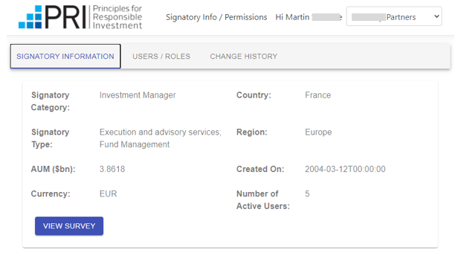
New dashboard
To see high-level information of the signatory organisation

Slide 30
Navigating the survey (1)
Key features of the new reporting tool
Choose one person to report at a given time
?
Stewardship not assessed in separate module – included in module scores
Respond to CORE (or mandatory) indicators before continuing
Extensively covered in the ‘ISP’ module to avoid repetition – aligned with STW 2.0 paper
In relevant asset class modules for asset-specific stewardship practices
Use the table of contents to navigate the survey
More space to report on (proxy) voting, shareholder resolutions and engagement with policy-makers
Choose disclosure setting for PLUS (or voluntary) indicators at the end of a module

Slide 31
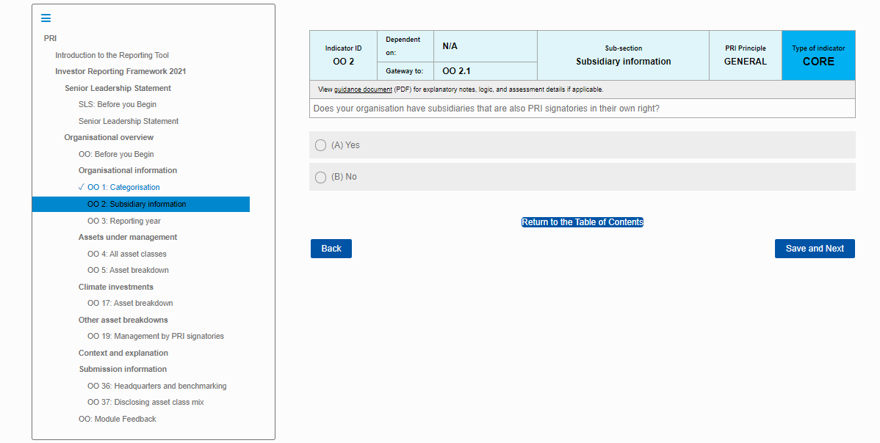
Navigating the survey (2)
What the new reporting platform looks like
Further details can be found in the user guide available once logged into the tool

Slide 32
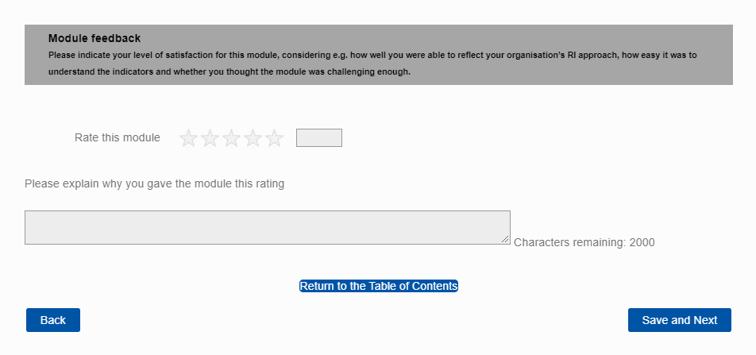
Providing voluntary feedback
We welcome signatory feedback throughout the pilot reporting cycle of the new Reporting Framework

Slide 33
Resources
More information and resources about Reporting and Assessment available at www.unpri.org/reporting​
The reporting process
Investor reporting guidance
Short module specific guides
Mapping documentation
Offline version of the Reporting Framework, including explanatory notes (PDF, MS Word and Excel format)
Reporting framework glossary
Service providers reporting guidance
How investors are assessed on their reporting
Reporting and assessment review
Minimum requirements for investors membership and Leaders Group

Slide 34
Q&A

Slide 35
Thank you
Contact:
yulia.sofronova@unpri.org
or Reporting & Assessment at reporting@unpri.org

